Slide 1

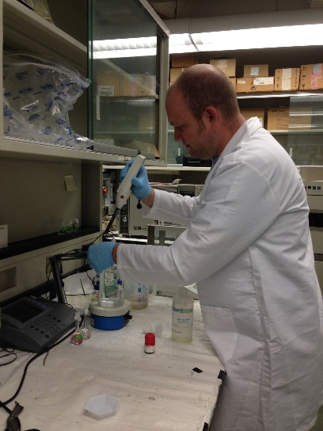
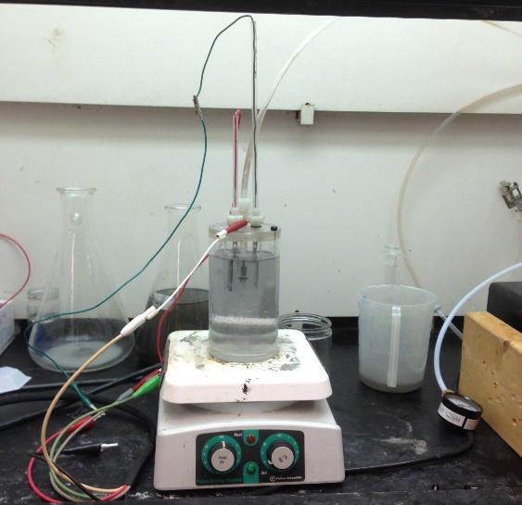
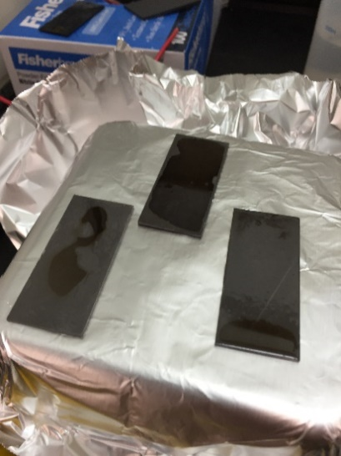
Catalytic Electrode Coatings for Removal of Pesticides from Drinking Water in Ozonation/Electrolysis Treatment Systems
RET Group Presentation
July 30th, 2015
Ashley Gregory, 7th Grade Science, Gray Middle School
Travis Hartberger, Chemistry & AP Chemistry, McKinley Tech High School
RET is funded by the National Science Foundation
grant # EEC-1404766.

Slide 2
Project Outline
Topic Slides
Abstract 2
Background 3-6
Literature Review 7-10
Goals/Objectives 11
Tasks/Timeline 12
Training 13-15
Findings/Summary 16-22
Unit Plans 23-26
Bibliography 27-29
Acknowledgements 30

Slide 3
Abstract
Abstract
2
This work details the assessment of catalysis on the synergistic ozonation/electrolysis degradation of atrazine
Atrazine degradation was optimal at a current density of 10.0mA/cm²
Manganese dioxide was evaluated as a heterogeneous catalyst on graphite by redox deposition and electrochemical deposition
The application of MnO₂ as a suspended solid and as an anode and cathode, demonstrated limited to no improvement to the adsorption of and, subsequent, oxidation of atrazine by ozone

Slide 4

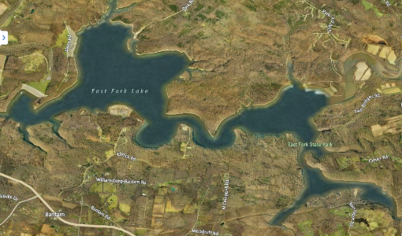
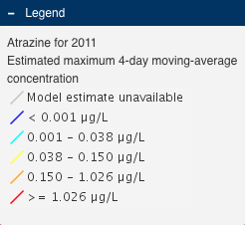
Why We Are Concerned
Introduction/
Background
3
USGS modeling results predict Atrazine levels of concern in surface water nationwide.
Closer to home
[1] Stone, W. W. and Bucknell, M. S., 2014, Watershed Regressions for Pesticides (WARP): U.S. Geological Survey Web Page, http://dx.doi.org/10.5066/F7R20ZD3

Slide 5
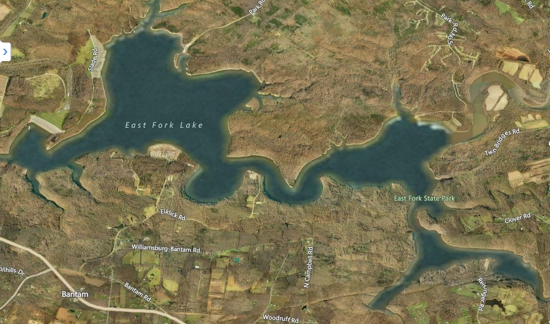
Closer to Home
Introduction/ Background
4
A USGS study detected 42 pesticides and related compounds, including Atrazine, in the water in East Fork Lake, a water source for over 40,000 people.
modern campground
swimming beaches
picnic areas
horse riding trails
hiking and backpacking trails
mountain bike trails

Slide 6
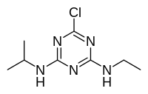
Atrazine, Our Model Pesticide
Introduction/ Background
5
Atrazine is one of the most commonly detected pesticides in the country.
It is slow to degrade in water, and often is adsorbed onto soil particles.
Atrazine has been shown to:
  Increase the risk of breast cancer in women^{[2]}
  Disrupt hormones and act to “feminize” animals^{[2]}
  Affect the human reproductive system^{[3]}
[2] Roy, J.R.; Chakraborty, S.; Chakraborty, T.R. Estrogen-like endocrine disrupting chemicals affecting puberty in humans - A review. Medical Science Monitor 2009, 15, RA137-RA145.
[3] Agency for Toxic Substances and Disease Registry. Public Health Statement: Atrazine. 2003

Slide 7
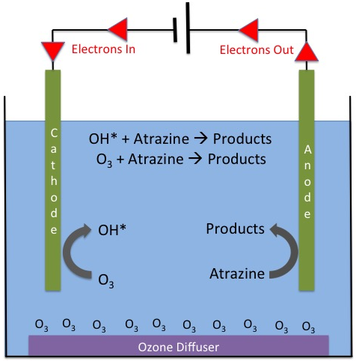
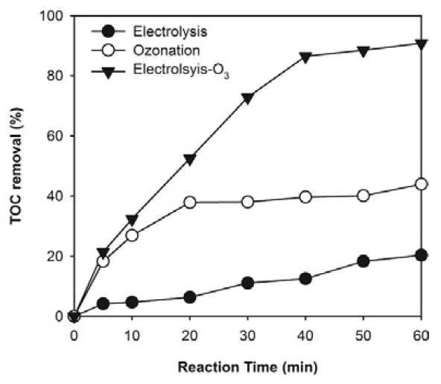
Ozonation and Electrolysis
Background
6
Why combine the two methods?^{[8]}
Atrazine Degradation
reversed-phase high-performance liquid chromatography (HPLC).
Current Density
Quantity used to indicate the amount of current applied to a surface
combined
SYNERGY
ozone only
electrolysis
Ozone Quantitation
Detect aqueous ozone using the Indigo Method.⁵
Electrode
Optimization
Limited studies in electrode materials, i.e. MnO₂ as a catalyst
Notes:
Citation for ozone quantification

Slide 8
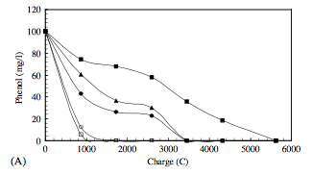

Catalytic Coatings
Literature Review
7
Catalyst – “a substance that increases the rate of a chemical reaction without itself undergoing any permanent chemical change.”
Change the properties of an electrode to provide various enhancements to the degradation of pollutants.
Ti/RuO₂
Ti/Sb-Sn-RuO₂
Ti/Sb-Sn-RuO₂-Gd
Pt
Ti-β-PbO₂
[4] Feng, Y. J., and Li, X.Y. (2003). "Electro-catalytic oxidation of phenol on several metal-oxide electrodes in aqueous solution." Water Research, Vol. 37 Issue 10, pp. 2399-2407.

Slide 9
Catalytic Activity
Literature Review
8
Naydenov and Mehandjiev^{[5]} reported a mechanism for MnO₂’s (Z) role in mineralizing benzene.
Yang et. al.^{[6]} showed mineralization Pharmaceutical Compounds (PhACs) with alumina-supported manganese oxide (MnO_{x}) suspension
Mn²⁺
MnO_{x}/CA
MnO_{x}/CMA
MnO_{x}/MA
Notes:
CA = nonporous alumina
CMA = commercial mesoporous alumina
MA = synthetic mesoporous alumina

Slide 10
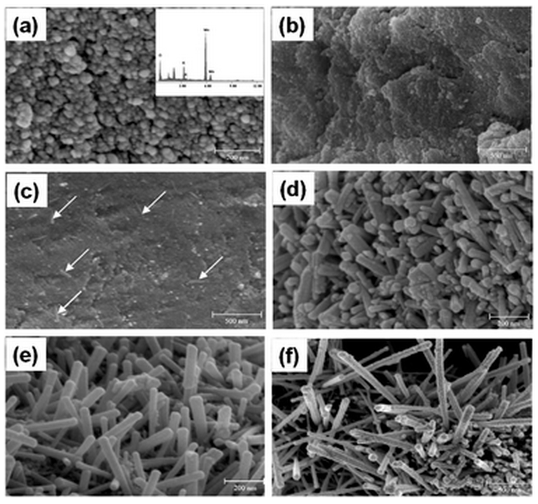
Deposition of MnO_{2 (s)}
Literature Review
9
Deposition Method
  Thermal deposition^{[4]}
    Annealing Temperature^{[11]}
  Electrochemical deposition
    Neutral pH^{[13]} vs. Adjusted pH^{[14]}
  Redox deposition^{[12]}
Electrode substrate
  Molybdenum filling^{[16]}
  Platinum priming^{[11]}
  Graphite^{[12]}
  Activated Carbon^{[15]}
50ºC
200ºC
300ºC
400ºC
500ºC
600ºC
Fig. 4 SEM images of MnO₂ (a) as prepared and dried at 50 °C in air (inset shows energy-dispersive X-ray spectrum) and annealed at (b) 200 °C, (c) 300 °C, (d) 400 °C, (e) 500 °C, and (f) 600 °C for 3 h in air. Arrows in (c) indicate initiation of nanorods.

Slide 11
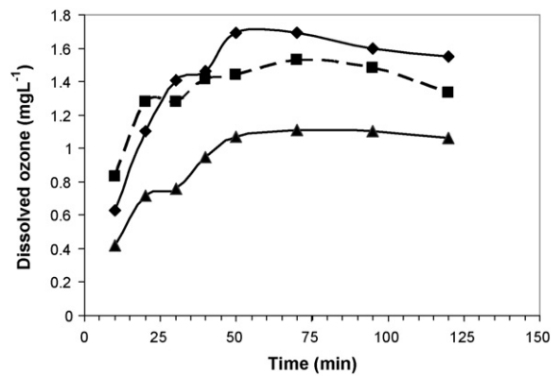
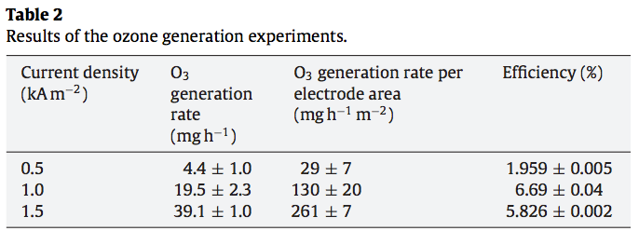
Current Density^{[7]}
Literature Review
10
Since changes in current density will effect the voltage of the reactor, we want to explore the current density effects on the mechanism(s) for degrading atrazine
Similar studies show impact of current density on ozone generation
1.5kA/m²
1.0kA/m²
0.5kA/m²

Slide 12
Goals/Objectives
Goal/Objectives
11
Goal:
Optimize an ozonation/electrolytic treatment of drinking water for removal of pesticides (i.e. atrazine)
Objectives:
Evaluate the changes in current density (mA/cm²) on the mechanism of atrazine degradation
Evaluate the effectiveness of catalytically active electrodes on the degradation of atrazine
  1.) Anode: BDD & Cathode: SS
  2.) Anode: G & Cathode: SS
  3.) Anode: G w/ MnO₂^{ED} & Cathode: SS
  4.) Anode: G w/ MnO₂RD & Cathode: SS
  5.) Anode: BDD & Cathode: SS (suspended MnO₂)
  6.) Anode: BDD & Cathode: G w/ MnO₂^{ED}
  7.) Anode: BDD & Cathode: G w/ MnO₂RD
  Note: BDD = Boron-doped Diamond ^{TD} = Thermal decomposition
  SS = Stainless Steel ^{ED} = Electrochemical deposition
  G = Graphite ^{RD} = Redox deposition
  Ti = Titanium
  MnO₂ = Manganese dioxide (catalyst)

Slide 13
Tasks & Timeline
Tasks & Timeline
12
Research Tasks
Evaluate the effect of current density on the degradation of atrazine
Develop a catalytic coated electrode which can be applied to the atrazine degradation system
Characterize the system with the coated electrode
Timeline to Complete Research Tasks
Completed Tasks as of July 16, 2015
Evaluation of current density on atrazine
-10.0 mA/cm² appears optimal
Completed Tasks as of July 20, 2015
1. Characterize the atrazine degradation system
  Testing different masses of MnO2 suspended within the atrazine solution
  Testing of developed catalytic electrodes in comparison to BDD electrode

Slide 14
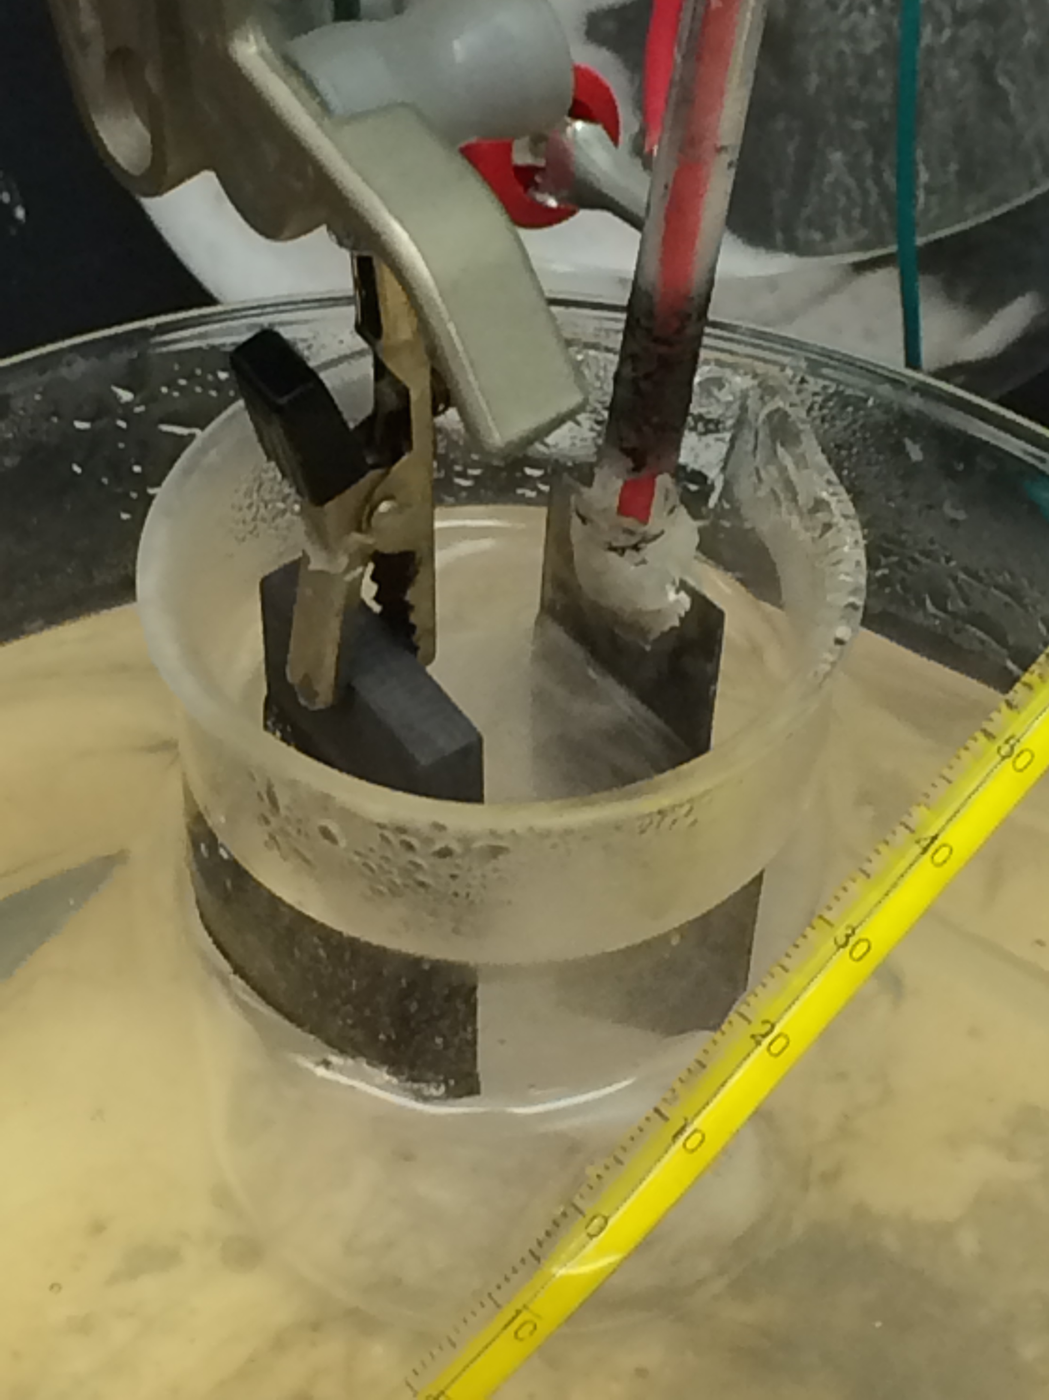
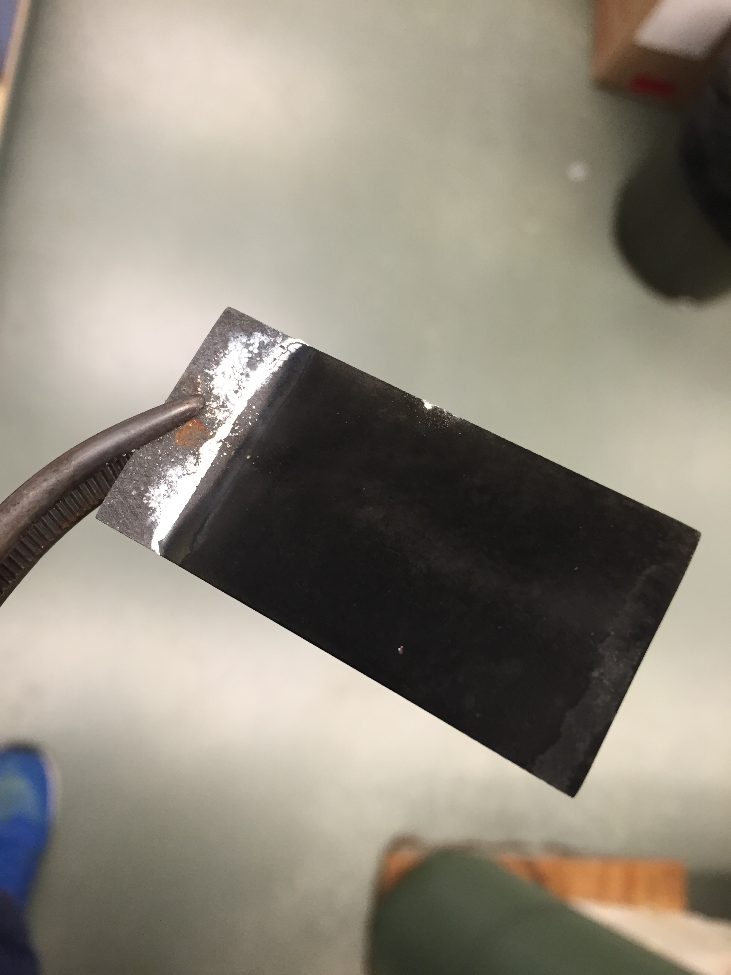
Training Received
Training Received
13
Figure 2: Graphite electrode coated with MnO₂ _{(s)} by anodic deposition using 0.25 M MnSO₄*H₂O _{(aq)} with a current density of10mA/cm² at 98ºC and annealed at 450 ºC
Figure 1: Anodic deposition of MnO₂ _{(s)} on graphite anode using a stainless steel cathode with 0.25 M MnSO₄*H₂O_{(aq)} and a current density of 10mA/cm².

Slide 15
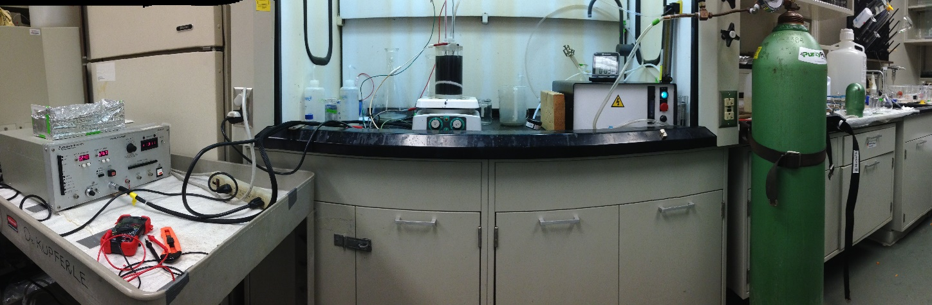
Training Received
Training Received
14
Ozonation/Electrolysis Reaction Chamber:
Compressed oxygen cylinder
Ozone generator and flow meter
Potentiostat and electrode system
Ag/AgCl Reference electrode
Reaction sampling for ozone quantification and HPLC
Notes:
Preparation of Potassium Indigotrisulfonate solution (200mg/L)
100 mL volumetric flask
μΩ water (solvent)
pH=2 buffer (2.22 mL H₃PO₄ & 5.62 g NaH₂PO₄)

Slide 16
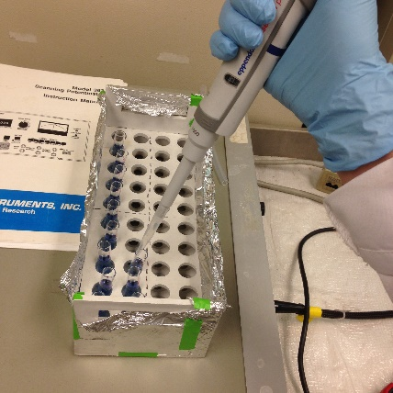
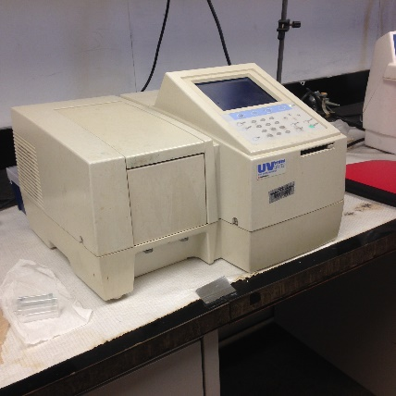
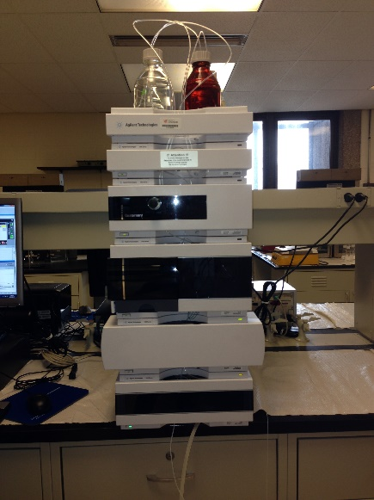
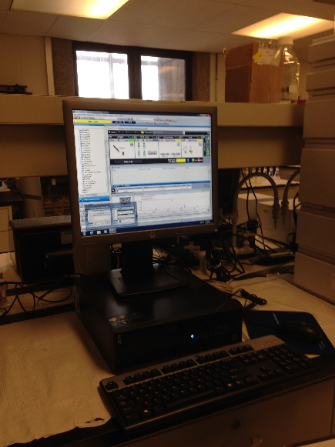
Training Received
Training Received
15
Ozone Quantification^{[5]}:
Preparation of Potassium Indigo
trisulfonate solution (200mg/L)
Absorbance using UV-Vis Spectrophotometer at 600 nm
Calibration: algebraic calculation of [ozone] in mg/L from absorbance
Degradation of Atrazine:
Preparation of HPLC vials using Na₂S₂O₃ as an ozone quencher
Data collection from HPLC chromatograms (integration for area under the curve)
Notes:
Preparation of Potassium Indigotrisulfonate solution (200mg/L)
100 mL volumetric flask
μΩ water (solvent)
pH=2 buffer (2.22 mL H₃PO₄ & 5.62 g NaH₂PO₄)

Slide 17
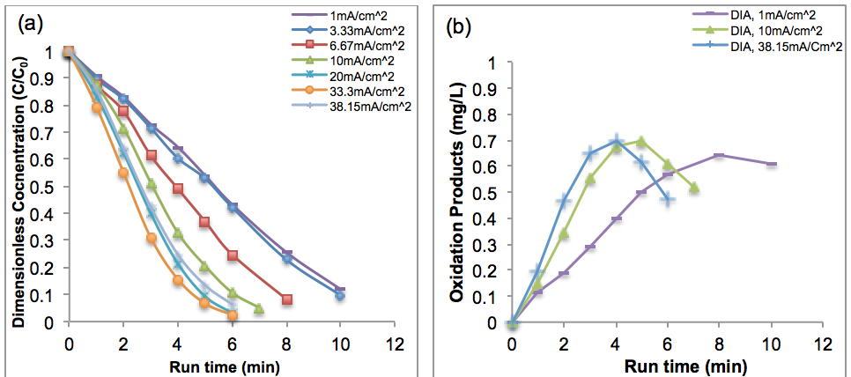
Figure 1
Findings
16
The Effect of Current Density on Degradation of Atrazine
>20mA/cm² exceeds mass-transport
1mA/cm²
10mA/cm²
38mA/cm²
>20mA/cm² exceeds mass-transport.
>20mA/cm² exceeds mass-transport.
>20mA/cm² exceeds mass-transport.
>20mA/cm² exceeds mass-transport.

Slide 18
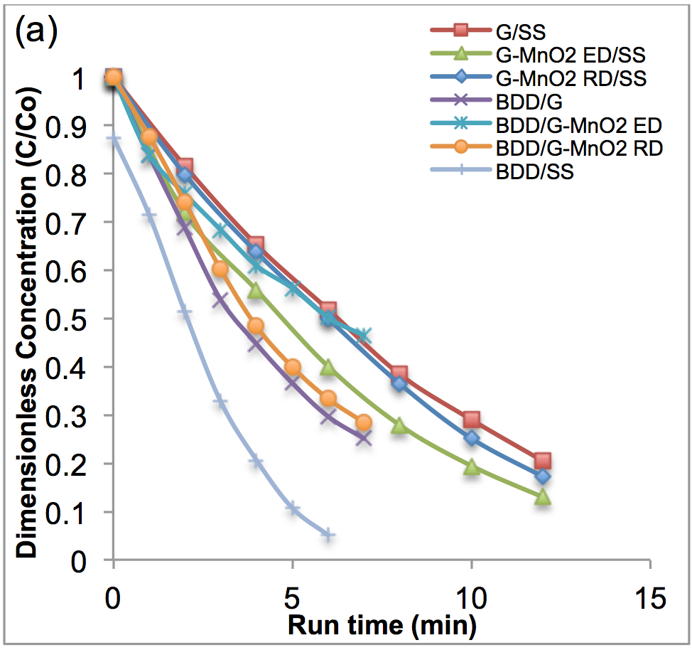
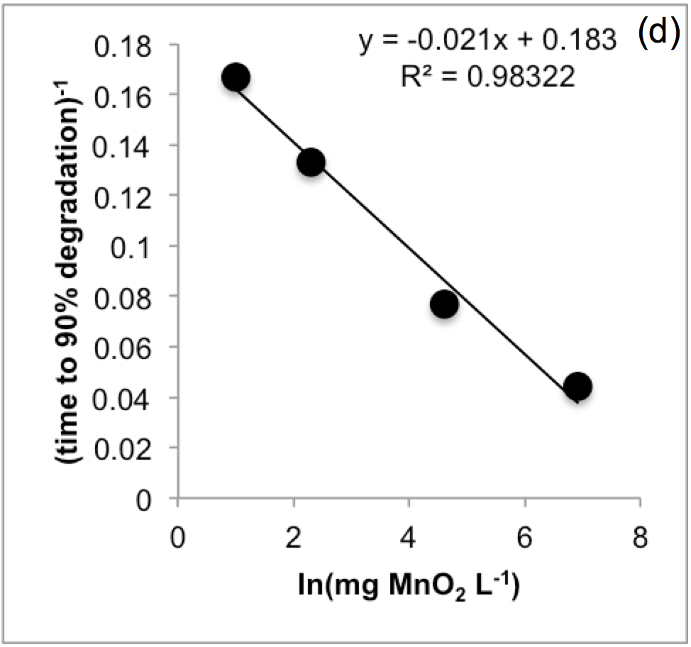
Figure 2
Findings
17
The Effect of MnO₂ on Degradation of Atrazine
G/SS
⬆MnO₂
⬇reaction rate
G-MnO₂/SS
BDD/SS
>20mA/cm² exceeds mass-transport.
>20mA/cm² exceeds mass-transport.
>20mA/cm² exceeds mass-transport.
>20mA/cm² exceeds mass-transport.

Slide 19
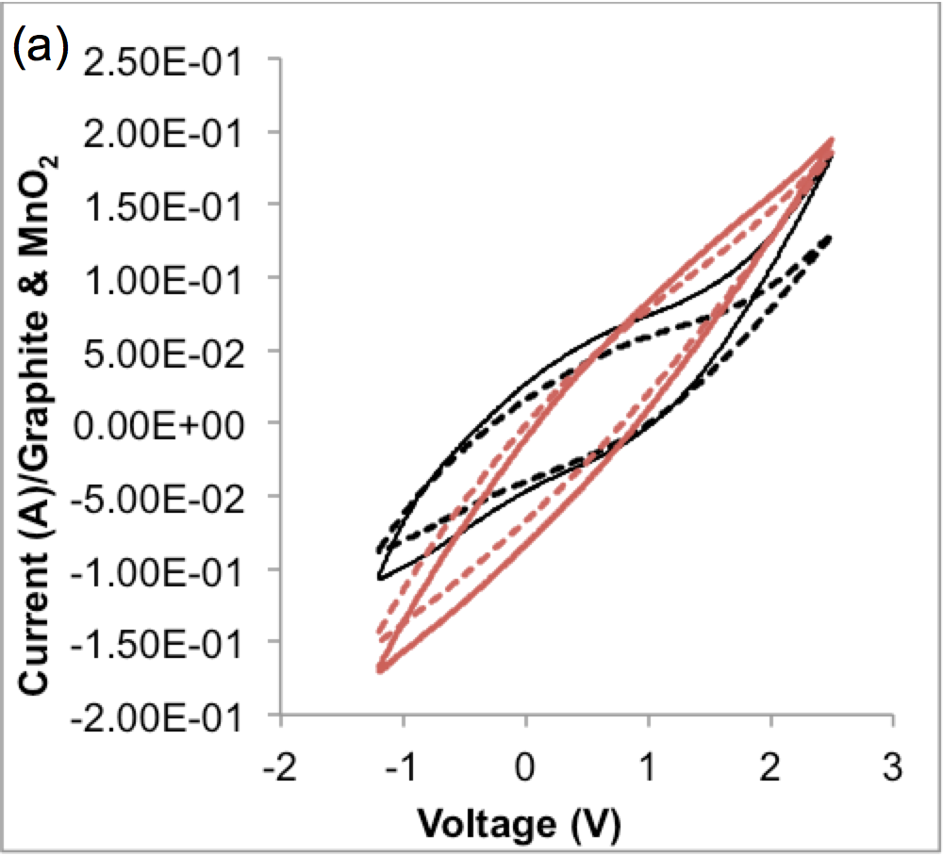
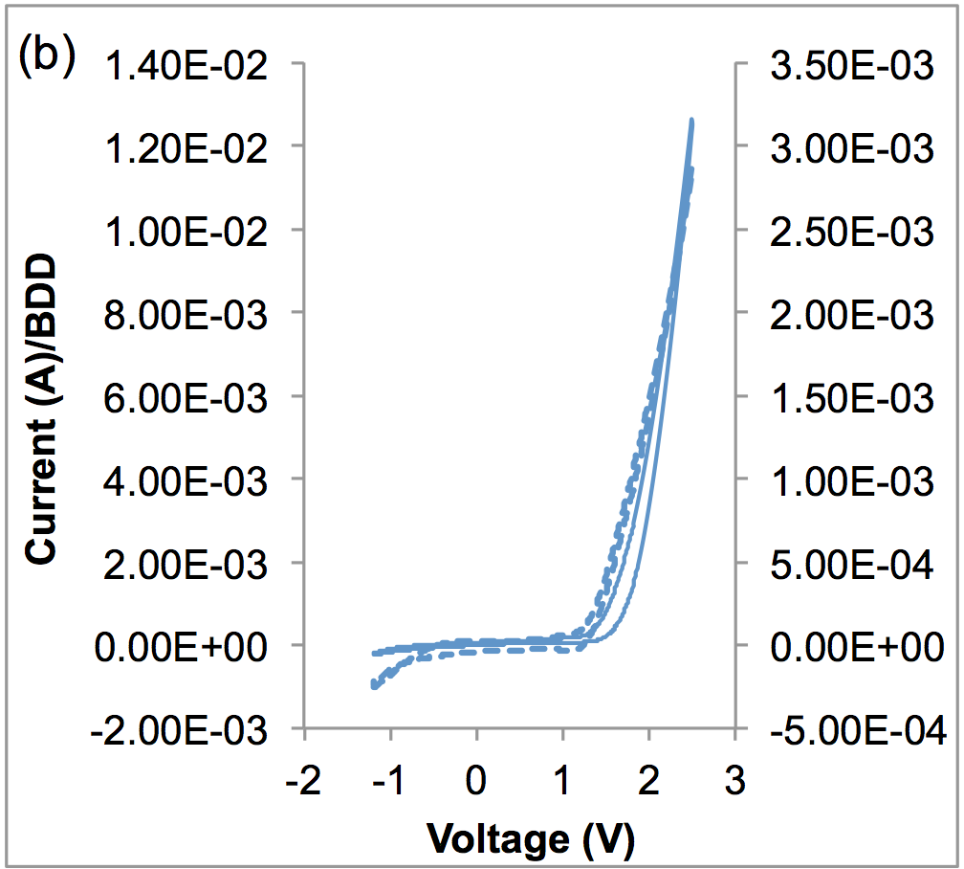
Figure 3
Findings
18
Cyclic Voltammetry
>1.4V
OER
BDD/SS
G-MnO₂/SS
>1.4V
OER
G/SS
>20mA/cm² exceeds mass-transport.
>20mA/cm² exceeds mass-transport.
>20mA/cm² exceeds mass-transport.
>20mA/cm² exceeds mass-transport.

Slide 20
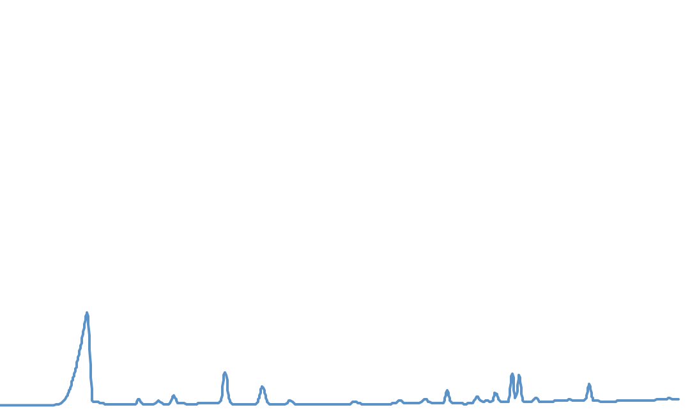

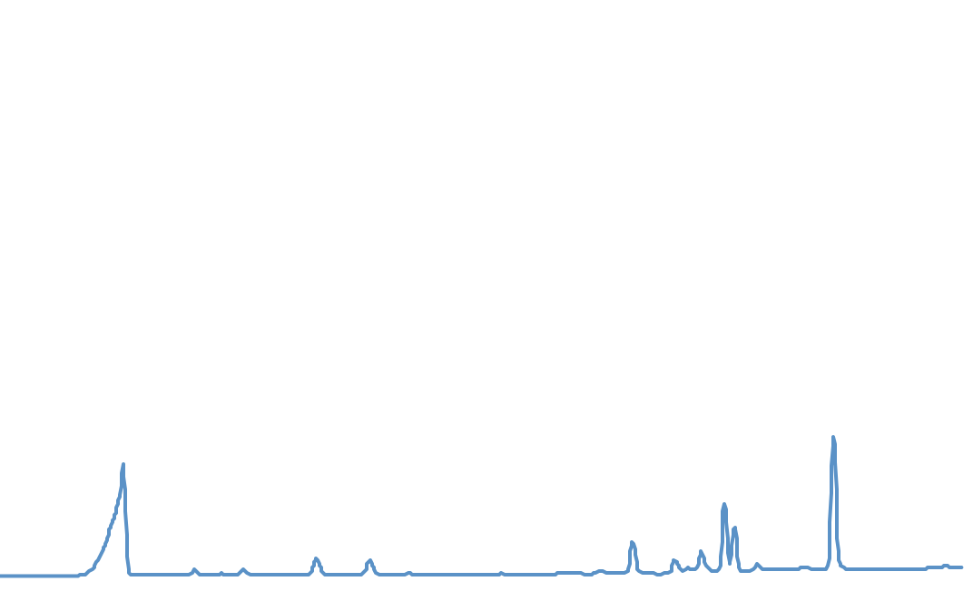
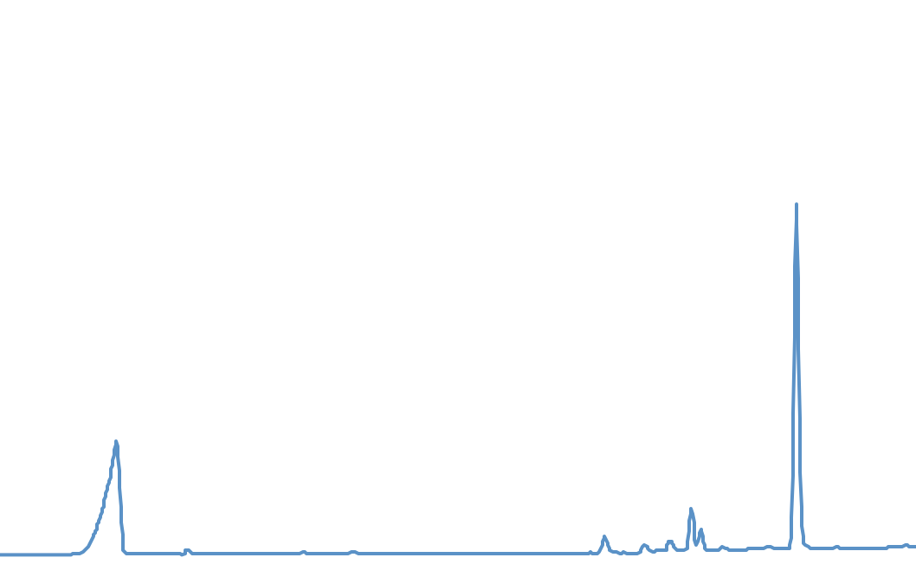
Figure 4
Progress
19
The Effect of Current Density & Voltage on Degradation of Atrazine
Chromatogram of Ozonation/Electrolysis (10mA/cm²)
desethyl
atrazine
desethyl
desisopropyl
atrazine
atrazine
6 minutes
4 minutes
desisopropyl atrazine
2 minutes
electrolyte
0 minutes
>20mA/cm² exceeds mass-transport.

Slide 21
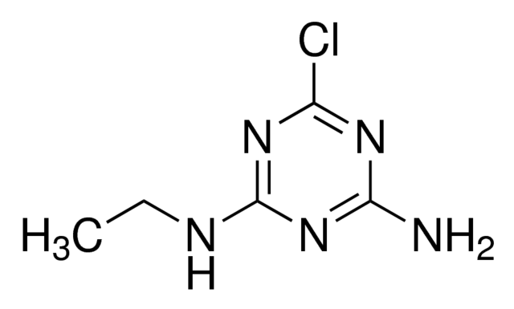
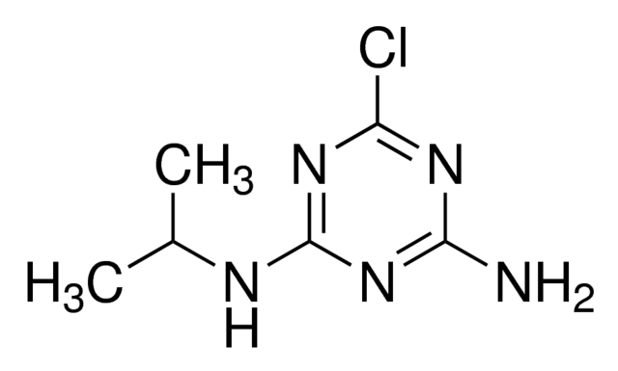
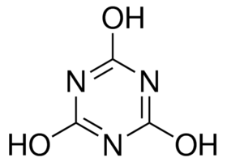
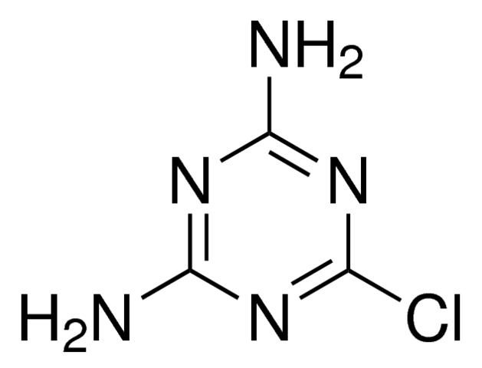
Figure 5
Findings
20
Reaction Pathway
atrazine
O₃ / •OH
O₃ / •OH
DIA
DEA
•OH
O₃ / •OH
O₃ / •OH
•OH
cyanuric
acid
cyanuric
acid
DDA
•OH
O₃ / •OH
•OH
[CO₂, H₂O, N₂, Cl₂]
>20mA/cm² exceeds mass-transport.
>20mA/cm² exceeds mass-transport.
>20mA/cm² exceeds mass-transport.
>20mA/cm² exceeds mass-transport.

Slide 22
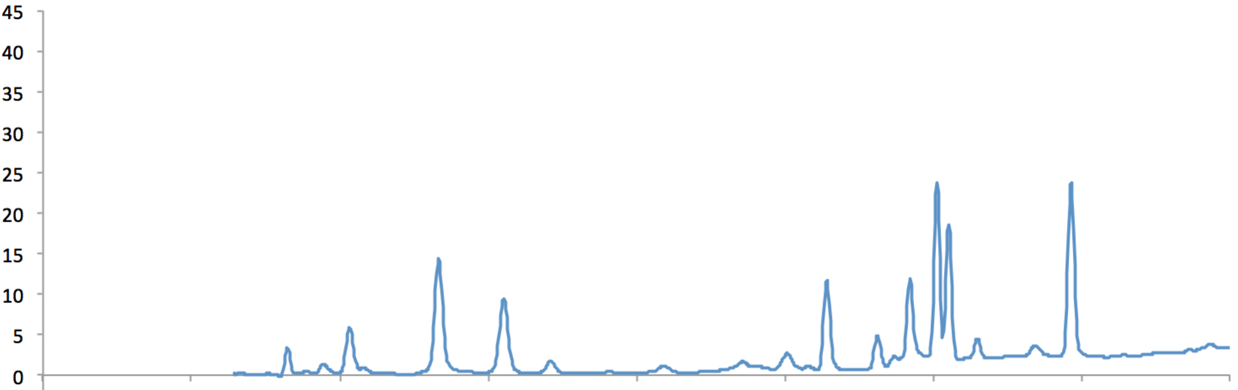
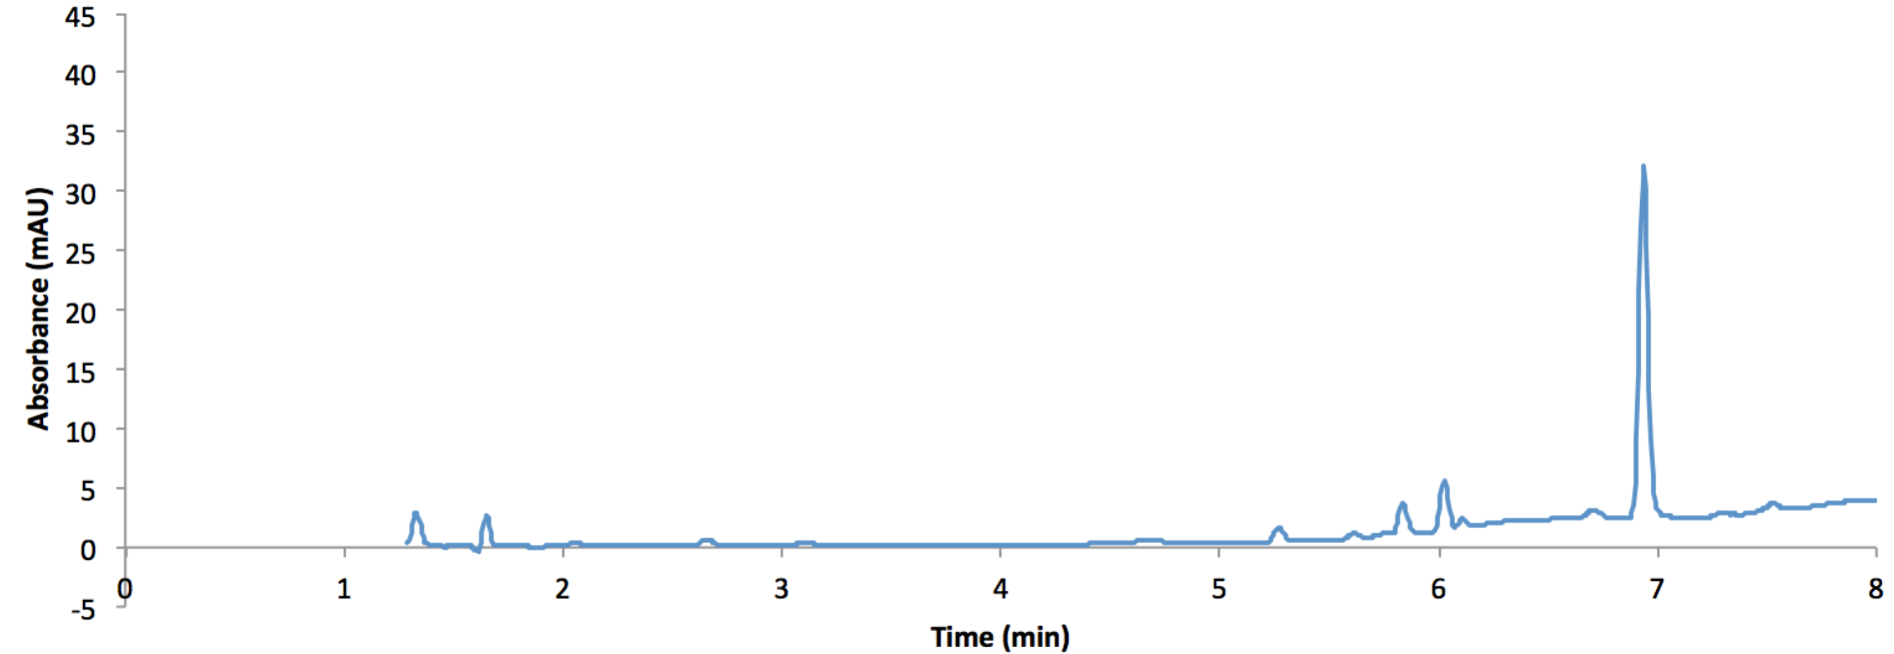
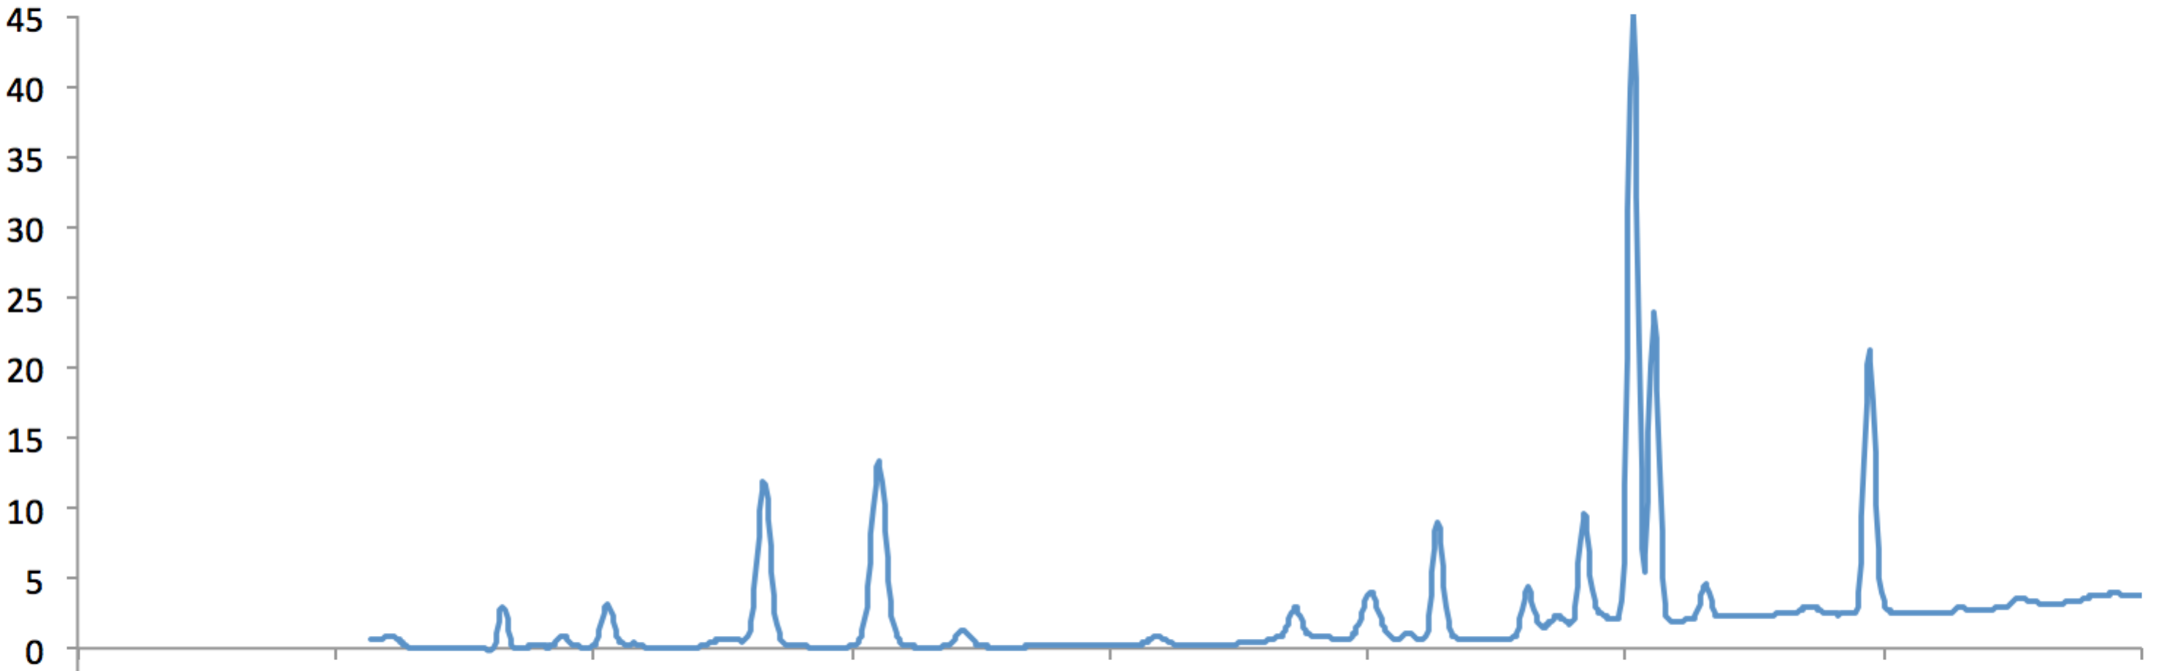
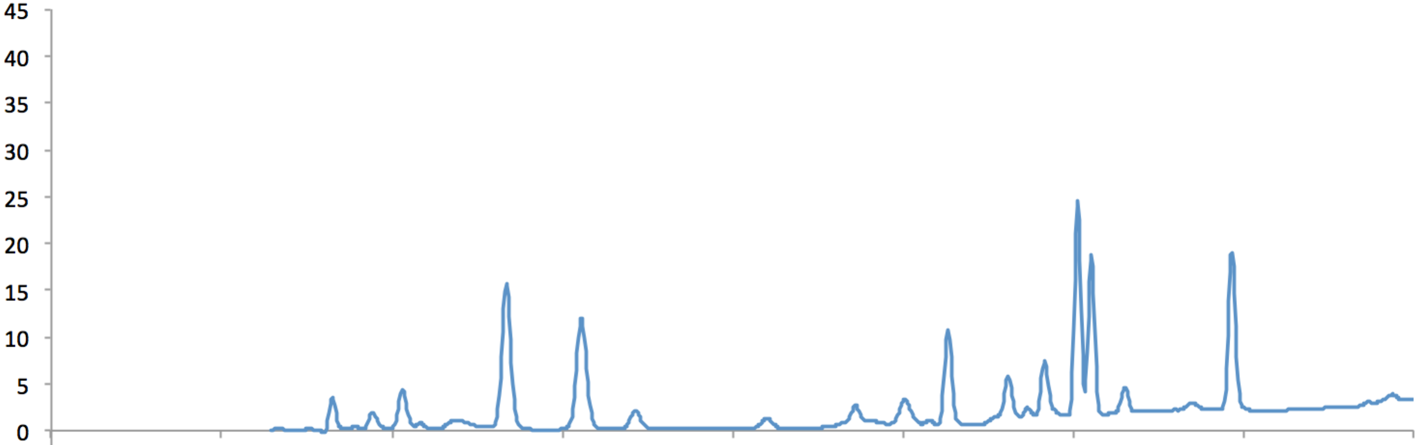
Figure 6
Findings
21
HPLC chromatograms at sampling times with ~90% atrazine degradation
Ozonation & ozonation/electrolysis combined are not significantly different
MnO₂
does not alter the pathway of atrazine degradation
Electrolysis
Ozonation/Electrolysis
Ozone/Electrolysis + MnO₂
Ozonation
Atrazine is mineralized
>20mA/cm² exceeds mass-transport.
>20mA/cm² exceeds mass-transport.
>20mA/cm² exceeds mass-transport.
>20mA/cm² exceeds mass-transport.

Slide 23
Summary
Summary
22
Atrazine degradation was optimal at a current density of 10.0mA/cm²
At current densities >20.0mA/cm², the ozonation/electrolysis synergism was less favored due to ozone stripping and current-limiting mass-transport.
The application of MnO₂ as a suspended solid and as an anode and cathode, demonstrated limited to no improvement to the adsorption of and, subsequent, oxidation of atrazine by ozone
Manganese dioxide’s oxidant competition with ozone and no apparent change or improvement to the ozonation/electrolysis pathway to oxidize atrazine.

Slide 24
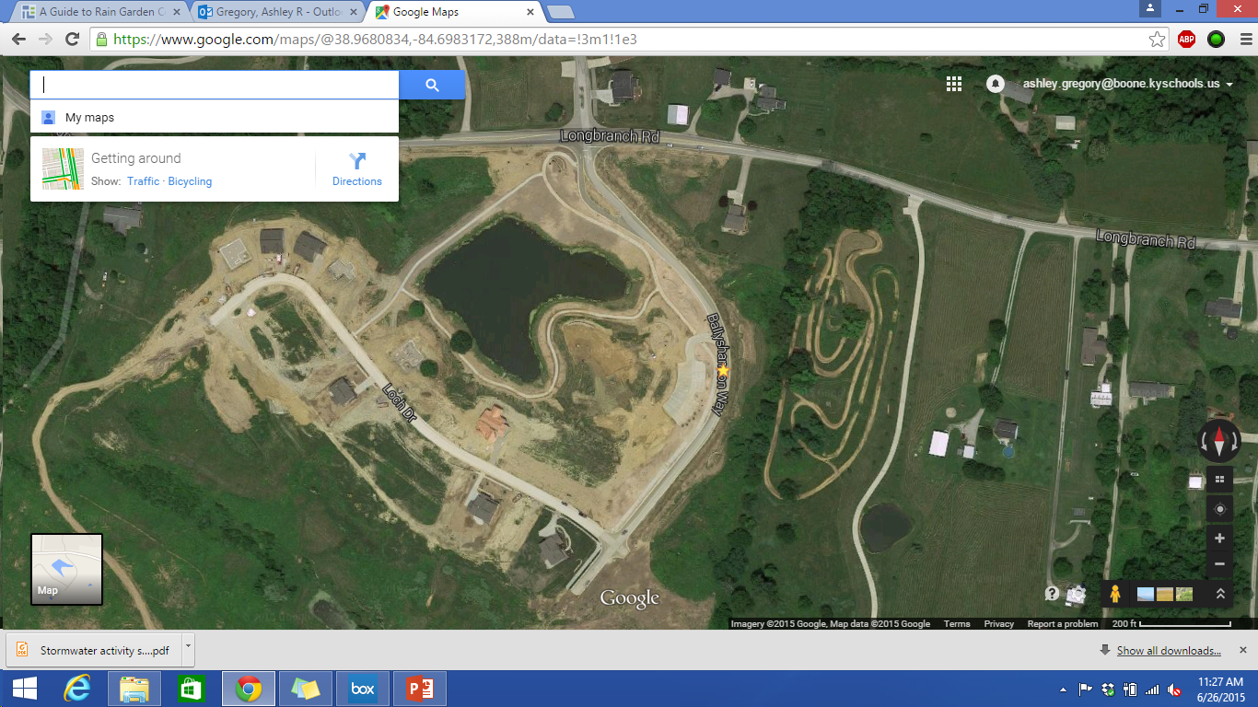
Unit Topic: Using Green Infrastructures
To Reduce Run-off Pollutants
Unit Plan
23
Course: Physical Science
Grade Level: 7
Essential Question: How can we decrease the amount of polluted run-off entering the surface water system in a developing community?
Challenge: To create a green infrastructure which will decrease the amount of pollutants entering the surface water system in a developing community.
Development of Ballyshannon Way in Union, Kentucky
(Google Maps)

Slide 25
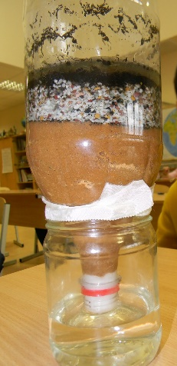
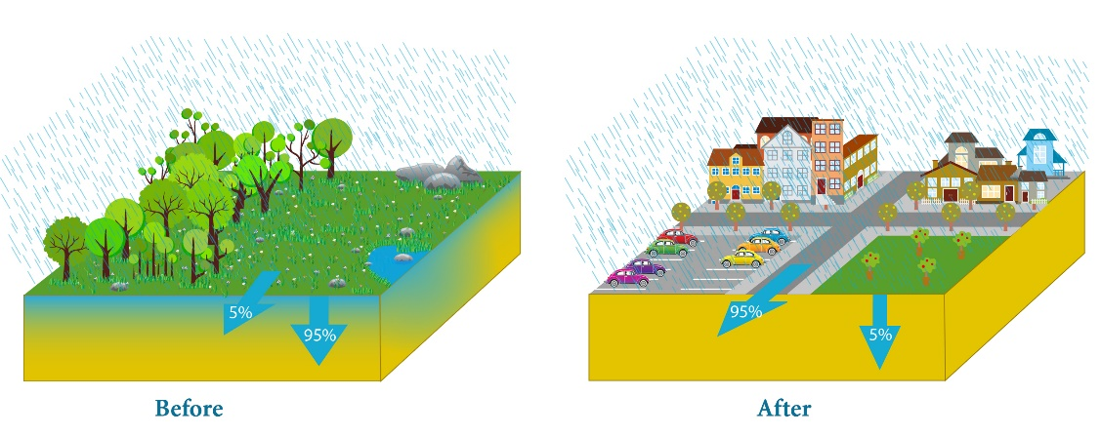
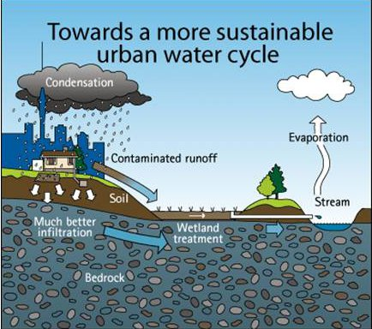
Unit Topic: Using Green Infrastructures
To Reduce Run-off Pollutants
Unit Plan
24
General Outline of Unit Lessons and Activities:
Lesson One: Surface Water Pollution
Activity One: The Hook: Building A Water Filter
Activity Two: Natural and Urban Water Cycles
Lesson Two: Green Infrastructures
Activity One: Plant Roles in Green Infrastructures
Activity Two: The Challenge: Designing a Green Infrastructure

Slide 26
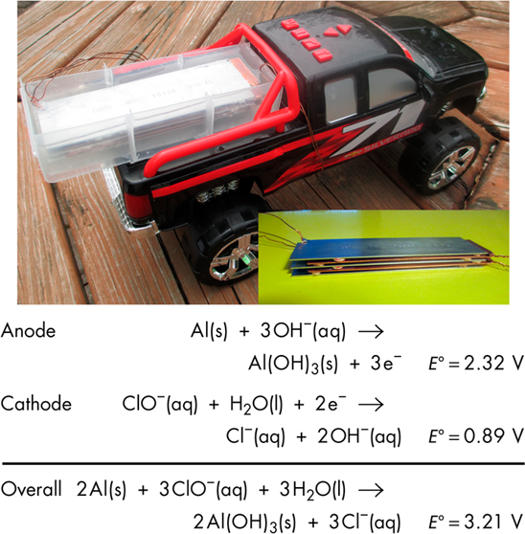
Unit Topic: Creating a High Performance, “Green” Battery
Unit Plan
25
Course: AP Chemistry
Grade Level: 11-12
Essential Question: How can we optimize use and type of household materials as well as electrode properties (surface area and spacing) to create a high-performance, “green” battery assembly?
Challenge: To build a high-performance, “green” battery assembly using common household materials that will be able to power the motors of various toy cars.
[17] Furlan, P.Y., Krupa, T., Naqiv, H., and Anderson, K. (2013). “An Open-Ended Project: Building a High Performance, yet Simple, Household Battery” Journal of Chemical Education. Vol. 90, 1341-1345.

Slide 27
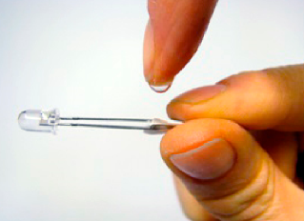
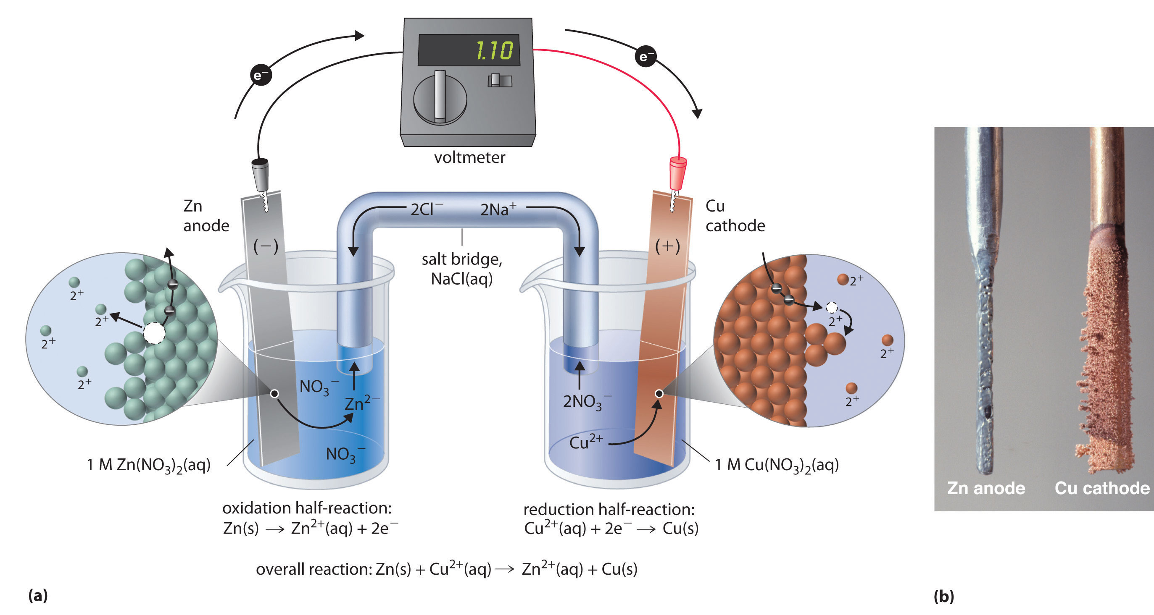
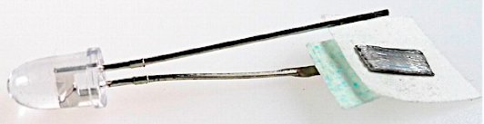
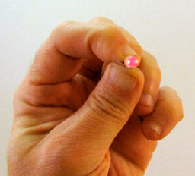
Unit Topic: Creating a High Performance, “Green” Battery
Unit Plan
26
General Outline of Unit Lessons and Activities:
Lesson One: Intro to Electro chemistry
Activity One: The Hook: Building a standard battery-power car
Activity Two: Electrochemical and Electrolytic Cells
Lesson Two: Designing and Testing Batteries
Activity Three: Manipulating Components of a Battery
Activity Four: The Challenge: Designing a “Green” High-Performance Battery

Slide 28
References
Bibliography
27
Stone, W. W. and Bucknell, M. S. (2014), “Watershed Regressions for Pesticides (WARP).” U.S. Geological Survey, http://cida.usgs.gov/warp/home/ (June 26, 2015)
Roy, J.R.; Chakraborty, S.; Chakraborty, T.R. (2009). “Estrogen-like endocrine disrupting chemicals affecting puberty in humans - A review.” Medical Science Monitor, Vol. 15, pp. RA137-RA145.
Agency for Toxic Substances and Disease Registry (2003). Public Health Statement: Atrazine CAS#: 1912-24-9.
Feng, Y. J., and Xiao Y. Li. (2003). "Electro-catalytic oxidation of phenol on several metal-oxide electrodes in aqueous solution." Water Research, Vol. 37, Issue. 10, pp. 2399-2407.
Naydenov, A. and Mehandjiev, D. (2003) Complete oxidation of benzene on manganese dioxide by ozone. Applied Catalysis A: General, 97 (1), 17-22.
Yang, L.; Hu, C.; Nie, Y.; Qu, J. (2009) Catalytic ozonation of selected pharmaceuticals over mesoporous alumina-supported manganese oxide. Environ. Sci. Technol., 43 (7), 2525-2529.

Slide 29
References
Bibliography
28
Bader, H. and Hoigné, J. (1981). “Determination of Ozone in Water by the Indigo Method,” Water Research, Vol. 15, pp. 449-456
Kanani, N. (2005). Electroplating: Basic Principles, Processes and Practice. Elsevier, Ltd.
Vera, Y.M., José de Carvalho, R., Torem, M. L., Calfa, B.A. (2009). “Atrazine degradation by in situ electrochemically generated ozone” Chemical Engineering Journal, Vol. 155, pp. 691–697.
Qiua, C., Yuana, S., Li, X., Wanga, H., Bakheet, B., Komarneni, S., Wang, Y. (2014). “Investigation of the synergistic effects for p-nitrophenol mineralization by a combined process of ozonation and electrolysis using a boron-doped diamond anode,” Journal of Hazardous Materials Vol. 280, pp. 644–653
Wei, W., Xinwei Cui, X., Chen, W., and Douglas G. Ivey, D.G. (2011). “Manganese oxide-based materials as electrochemical supercapacitor electrodes,” Chem. Soc. Rev., Vol. 40, pp. 1697-1721.
Wua, M., Snooka, G.A., Chena, G.Z., Fraya, D.J. (2004). “Redox deposition of manganese oxide on graphite for supercapacitors,” Electrochemistry Communications, Vol. 6, Issue 5, pp. 499–504

Slide 30
References
Bibliography
29
Shinomiyaa, T., Guptaa, V., Miura, N., (2006). “Effects of electrochemical-deposition method and microstructure on the capacitive characteristics of nano-sized manganese oxide,” Electrochimica Acta, Vol. 51, Issue 21, pp. 4412–4419
Hu, C. and Tsou, T. (2001). “Ideal capacitive behavior of hydrous manganese oxide prepared by anodic deposition,” Electrochemistry Communications, Vol. 4, Issue 2, pp. 105–109
Wang, J., Chen, Y., and Chen, B. (2015). “A Synthesis Method of MnO₂/Activated Carbon Composite for Electrochemical Supercapacitors,” Journal of the Electrochemical Society, Vol. 162, Issue 8, pp. A1654-A1661
Nakayama, M., Tanaka, A., Sato, Y., Tonosaki, T., and Ogura, K. (2005) “Electrodeposition of Manganese and Molybdenum Mixed Oxide Thin Films and Their Charge Storage Properties” Langmuir, Vol. 21, pp. 5907-5913
Furlan, P.Y., Krupa, T., Naqiv, H., and Anderson, K. (2013). “An Open-Ended Project: Building a High Performance, yet Simple, Household Battery” Journal of Chemical Education. Vol. 90, 1341-1345.

Slide 31

Acknowledgements
30
The RET program funded by the National Science Foundation
Grant ID# EEC-1404766
Project Faculty Mentor, Dr. Margaret Kupferle
Graduate Research Assistant, Mr. Greg Saylor
Project Faculty Mentor, Dr. George Sorial
RET Project Director and Principal Investigator, Dr. Anant R. Kukreti
Resource Person & Grant Coordinator, Debbie Liberi
RET Resource Teacher, David Macmorine

